Slide 1
Sharing Objectives
A f L

Slide 2
Sharing Objectives
From WJEC Mark Scheme –
a 2 Year development
For a Lesson Objective -
a 1 hour class
Think this through
Then translate into sharable obj
Show signs of a variety of structures, tenses and vocabulary
Use a variety of vocabulary and sentences to talk about my subjects at school

Slide 3
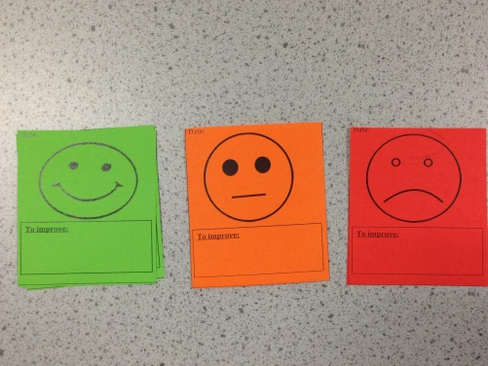
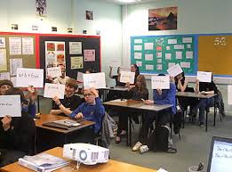
Red Amber Green Cards
Sharing Objectives
Post - its
A B C D Cards
- Synonyms/synonymous expressions
- 2/3/4/5/6 different kinds of sentence
- information clear
- organised
Peer Assessment?
Self Assessment?
Mini whiteboards
Verbal Assessment
of a quick check test?
Assessment stickers
Checklist – success criteria
My assessment scores:
1 2 3 4 5 6
Speaking Level
Listening Level
Reading Level
Writing Level
Overall Level
Questions?
Which ones?
Higher order?
Hands down?
Think / Wait / Talk time?
End of Year Target _________

